Slide 1
Questions
What are the objectives of ATS
What are the types of separation
What is the determining factor on wake turbulence?
Under what circumstances can an arriving aircraft be permitted to land?
Under what circumstances can a departing aircraft be permitted to take off?
What the five legs of an aerodrome traffic pattern
What are the main functions of an approach controller?
What is the objective of Flight Information Service?
What is the objective of Alerting Service?
What are the three phases for alerting service?

Slide 2
Objectives of the air traffic services
prevent collisions between aircraft;
prevent collisions between aircraft on the maneuvering area and obstructions on that area;
Expedite(加速) and maintain an orderly flow of air traffic;
provide advice and information useful for the safe and efficient conduct of flights;
notify appropriate organizations regarding aircraft in need of search and rescue aid, and assist such organizations as required.(10问答案)
ATC
FIS
Alerting Service

Slide 3
Types of Separation
Vertical separation
Lateral separation
Horizontal separation
Composite separation
Time separation
Distance separation
VFR separation
IFR separation (non-radar)
Radar separation
Wake turbulence separation

Slide 4
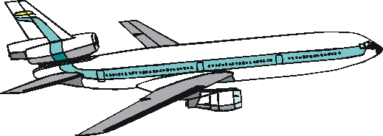
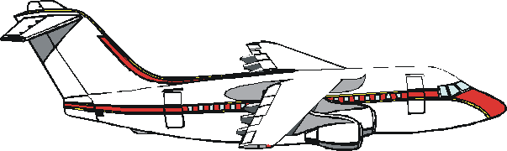
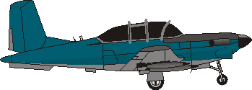
Wake turbulence Separation
Wake turbulence separation shall be applied between departing and departing, and arriving and arriving.
Wake turbulence separation minima is determined by maximum certificated takeoff mass.
Aircraft are classified according to their maximum certificated takeoff mass into three categories.
HEAVY: ≥ 136,000 kg
136,000 kg > MEDIUM > 7,000 kg
LIGHT: ≤ 7,000 kg

Slide 5
Wake turbulence Separation
Wake Turbulence Separation Based on Distance
Leading Aircraft | Following Aircraft | Separation Minima (km)
HEAVY | HEAVY | 8
HEAVY | MEDIUM | 10
HEAVY | LIGHT | 12
MEDIUM | LIGHT | 10
MEDIUM | HEAVY | 6
Airbus 380 |  | X + 4

Slide 6
Use of the runway
A landing aircraft will not normally be permitted to cross the runway threshold on its final approach until the preceding departing aircraft has crossed the end of the runway-in-use, or has started a turn, or until all preceding landing aircraft are clear of the runway-in-use.

Slide 7
Use of the runway
A departing aircraft will not normally be permitted to commence take-off until the preceding departing aircraft has crossed the end of the runway-in-use or has started a turn or until all preceding landing aircraft are clear of the runway-in-use.

Slide 8
Aerodrome Traffic Circuit
Downwind
Wind
Crosswind
Base
Final
Upwind

Slide 9









Approach Control
Metering （计量）
Merging(合并)
Sequencing
Spacing（隔开）

Slide 10
Flight Information Service
SIGMET and AIRMET information;
information concerning pre-eruption volcanic activity, volcanic eruptions and volcanic ash clouds;
information concerning the release into the atmosphere of radioactive materials or toxic chemicals;
information on changes in the serviceability of navigation aids;
information on changes in condition of aerodromes and associated facilities, including information on the state of the aerodrome movement areas when they are affected by snow, ice or significant depth of water;
information on unmanned free balloons;
weather conditions reported or forecast at departure, destination and alternate aerodromes;
collision hazards, to aircraft operating in airspace Classes C, D, E, F and G;
for flight over water areas, in so far as practicable and when requested by a pilot, any available information such as radio call sign, position, true track, speed, etc., of surface vessels in the area.

Slide 11
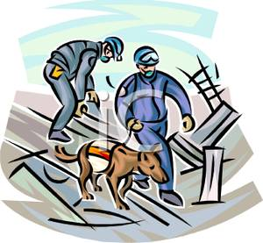
Alerting Service
Three phases
Uncertainty phase
Alert phase
Distress phase

